Slide 1



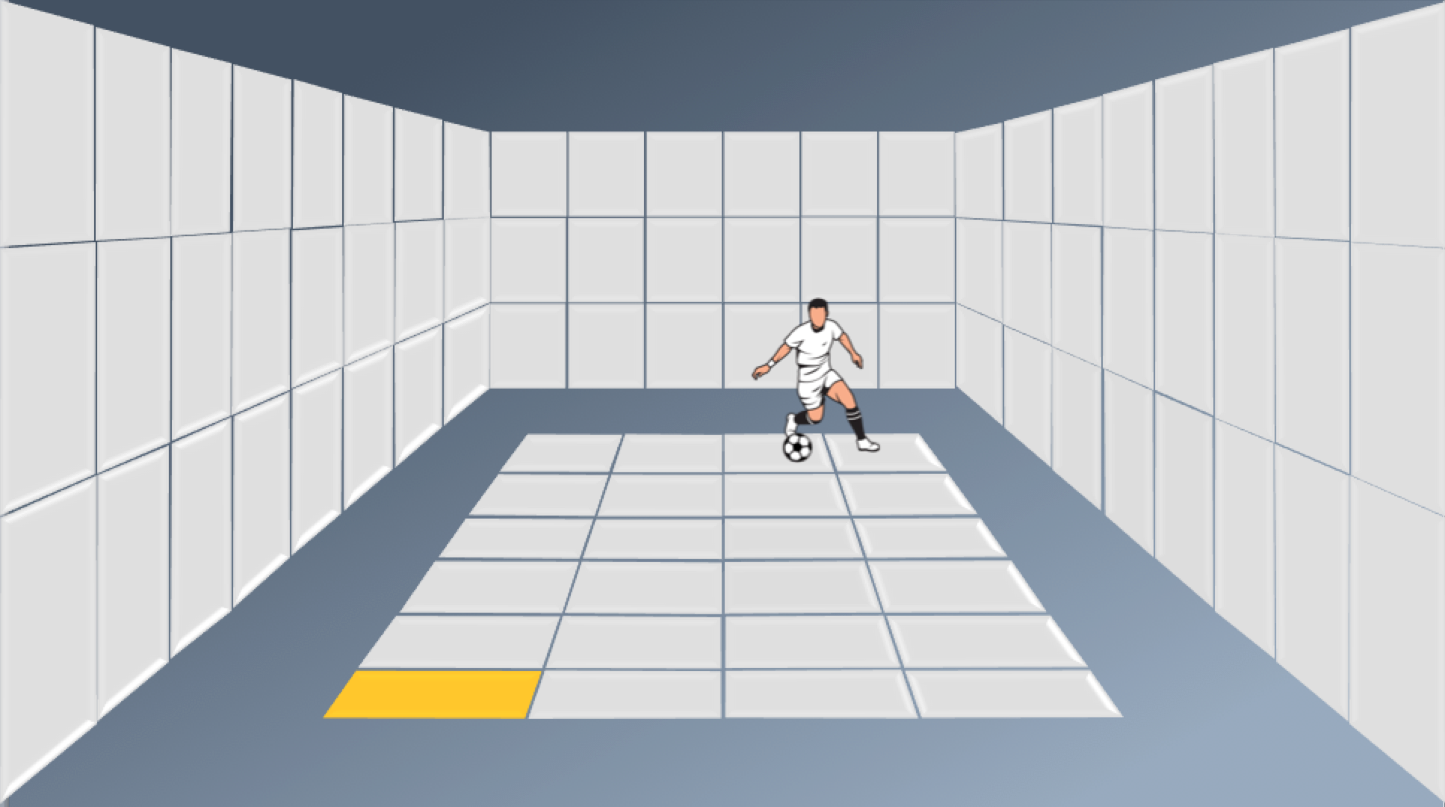
School of Computing & Information Sciences
SkillCourt 4.0
Senior Project, 2016, Spring
The Problem
Over the years, the process of training soccer players has remained the same. This means that the requirements have remained the same as well. Traditionally, players require a large field, a team, a goal, and a coach.
The fact is that this starts adding up rather quickly and any player without these resources will be getting a comparable sub-par experience in his or her training.
Centralization vs Decentralization
One of the most challenging parts of SkillCourt is the design of the system in itself. When speaking of centralized vs decentralized systems, both have upsides and downsides.
De-Centralized (Original)
The decentralized model does not require a central processor. Communication occurs from pad to pad directly.
Pros:
The pads can operate by themselves.
Can handle main pad failures.
Scalable
Modular in design.
Cons
Pads require more hardware.
All endpoints have to be secured.
Problems with version control.
Difficult to troubleshoot and maintain.
Centralized (New)
The centralized model requires a central processor. All communication goes from the processor then out to pads.
Pros:
Easier to maintain and troubleshoot.
More readily expandable.
Faster and more reliable.
Simpler pads.
Easier to secure.
Scalable
Ability to push updates to pads.
Cons
Must have central processor.
Requires a better main computer.
The Solution
SkillCourt plans to remedy this with the use of technology. No longer will an aspiring player need to spend a generous amount of money in resources and hire a coach in order to hone their skills:
- Application
- Websites
- Virtual Coaches
- Virtual Simulators
- Generated Sequences
- Saved Sequences
The Sequence Standard
One of the problems that arose from testing was the inability to store a sequence for future use. Everything being randomly generated does not allow for comparison between players or expertly designed sequences.
Introducing the Sequence Standard!
Information
Stores the general information of the sequence in question. This being, name, creator, game type, and anything relevant to the sequence itself.
Grids
These object store the general information about a grid, that is.. A set of tiles. These grids have a name, as well as a count of rows and columns.
The Future
With more development came more ideas. The design of SkillCourt has grown from initial stages. This means that it is more open to expansion and from this big plans are ahead!
- Ethernet pad communication - Gamemode Handling
- Floorpad handling
- Sequence Sharing
- Virtual games
- Web creator
Steps
A sequence is divided into steps. This being commands which occur at the same time. Adding onto this, intervals as well as delays after the step is executed.
Grid Commands
Steps require that commands be sent to specific tiles in specific grids, Grid Commands handle the grid in question as well as their specific tile. From this, it also carries the action of what happens to the grid. This being the color
All of this placed into a neat, loadable package.
Florida International University
Student: Lusi Puche
PO: Gumi Traustason, Jaime Borras
Instructor: Masoud Sadjadi
SkillCourt 4.0

